Slide 1

Review
Chapter 4

Slide 2
Statistical Inference: conclusion about population from a random sample
Point estimation
Average salary
Average CGPA
Hypothesis testing
Compare average salary of 2 populations
Compare average CGPA of 2 populations

Slide 3
Statistical Inference: conclusion about population from a random sample
Point estimation
Average salary
Average CGPA
Hypothesis testing
Compare average salary of 2 populations
Compare average CGPA of 2 populations

Slide 4

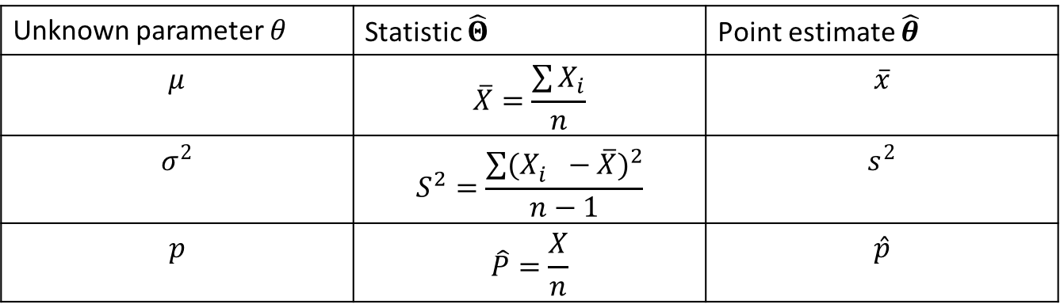
Point Estimation
Point estimator of 𝜃:
$\hat{Θ}=h(X_{1},X_{2},…,X_{n})$ takes the numerical value $\hat{θ}$
Unknown parameter 𝜃 | Statistic $\hat{Θ}$ | Point estimate $\hat{θ}$
$$μ$$ | $$\overline{X}=\frac{\sum{X_{i}}}{n}$$ | $$\overline{x}$$
$$σ^{2}$$ | $$S^{2}=\frac{\sum{{(X_{i}^{}−\overline{X})}^{2}}}{n−1}$$ | $$s^{2}$$
$$p$$ | $$\hat{P}=\frac{X}{n}$$ | $$\hat{p}$$

Slide 5
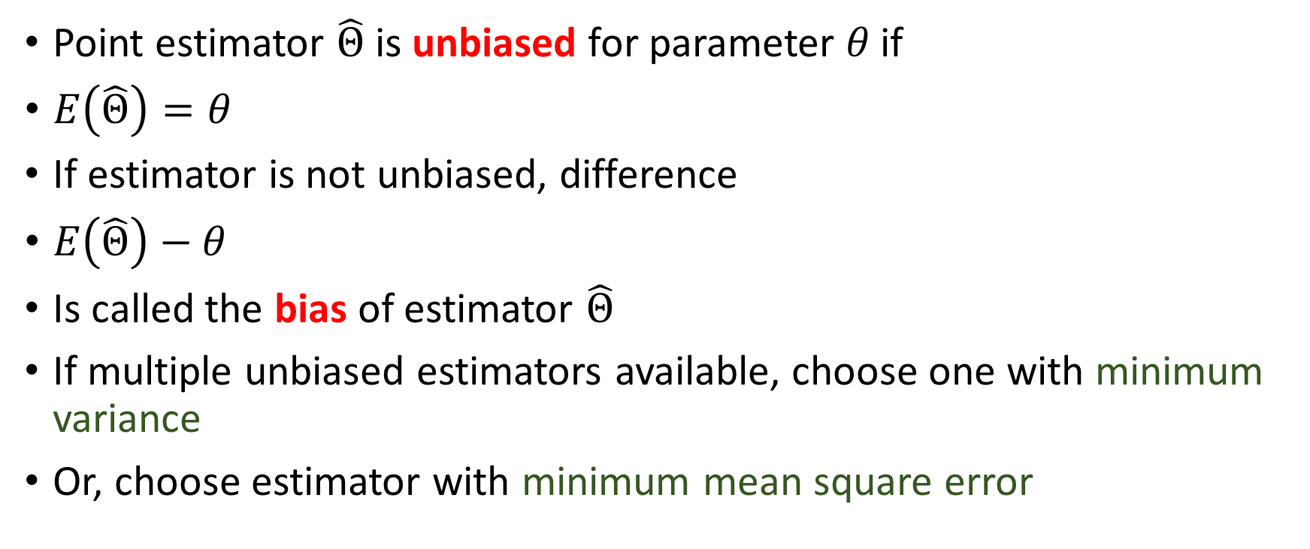
Biased versus unbiased estimators
Point estimator $\hat{Θ}$ is unbiased for parameter 𝜃 if
$E\left(\hat{Θ}\right)=θ$
If estimator is not unbiased, difference
$E\left(\hat{Θ}\right)−θ$
Is called the bias of estimator $\hat{Θ}$
If multiple unbiased estimators available, choose one with minimum variance
Or, choose estimator with minimum mean square error

Slide 6
Statistical Inference: conclusion about population from a random sample
Point estimation
Average salary
Average CGPA
Hypothesis testing
Compare average salary of 2 populations
Compare average CGPA of 2 populations

Slide 7
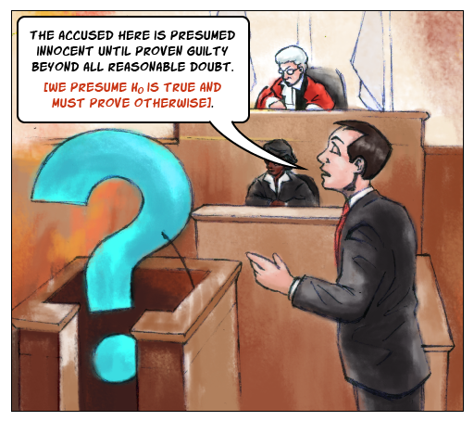
Hypothesis testing

Slide 8
Hypothesis testing
Null hypothesis H₀
Mean
Variance
Alternative hypothesis H₁

Slide 9
Types of errors
Type I
𝛼
Reject H₀ when it is true
Type II
𝛽
Fail to reject H₀ when it is false

Slide 10
Types of errors
Type I
𝛼
Reject H₀ when it is true
Type II
𝛽
Fail to reject H₀ when it is false

Slide 11
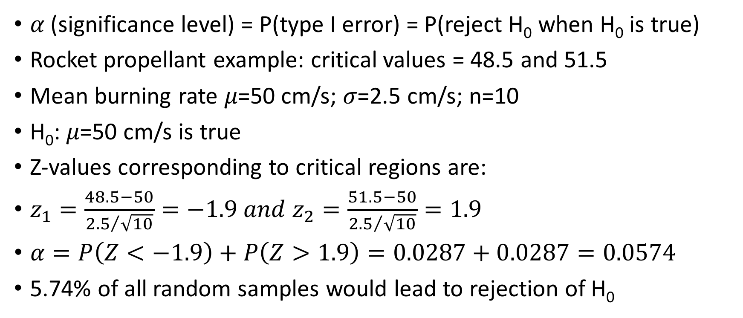
Type I error
𝛼 (significance level) = P(type I error) = P(reject H₀ when H₀ is true)
Rocket propellant example: critical values = 48.5 and 51.5
Mean burning rate 𝜇=50 cm/s; 𝜎=2.5 cm/s; n=10
H₀: 𝜇=50 cm/s is true
Z-values corresponding to critical regions are:
$z_{1}=\frac{48.5−50}{{2.5}/{\sqrt{10}}}=−1.9 and{ z}_{2}=\frac{51.5−50}{{2.5}/{\sqrt{10}}}=1.9$
$α=P\left(Z<−1.9\right)+P\left(Z>1.9\right)=0.0287+0.0287=0.0574$
5.74% of all random samples would lead to rejection of H₀

Slide 12
Non-rejection region
Critical value
Critical value
Rejection region
Rejection region
𝜇

Slide 13
Types of errors
Type I
𝛼
Reject H₀ when it is true
Type II
𝛽
Fail to reject H₀ when it is false

Slide 14
Normal distribution under H₀ and H₁
Critical value
Distribution under H₀
Distribution under H₁
𝛽=P(type II error)
= P(fail to reject H₀ when H₀ is false)
Power
𝛽
𝛼

Slide 15
P values
P value is a probability
Probability of finding the observed results or extremes given the null hypothesis is true
If null hypothesis is true, p value will be large
If null hypothesis is false, p value will be small
Reject null hypothesis if p value is less than the significance level 𝛼
Remember: p value is calculated to reject the null hypothesis! You are checking for extremes!

Slide 16
p-value
Most likely observation
A p-value (shaded blue area) is the probability of observed (or more extreme) results under null hypothesis
p-value
Very unlikely observations
Very unlikely observations
Observed data point

Slide 17

One tailed versus two tailed test
Two tailed test:
$H_{0}:μ=μ_{0}$
$H_{1}:μ≠μ_{0}$
One tailed test:
$H_{0}:μ=μ_{0}$
$H_{1}:μ<μ_{0} or>μ_{0}$

Slide 18
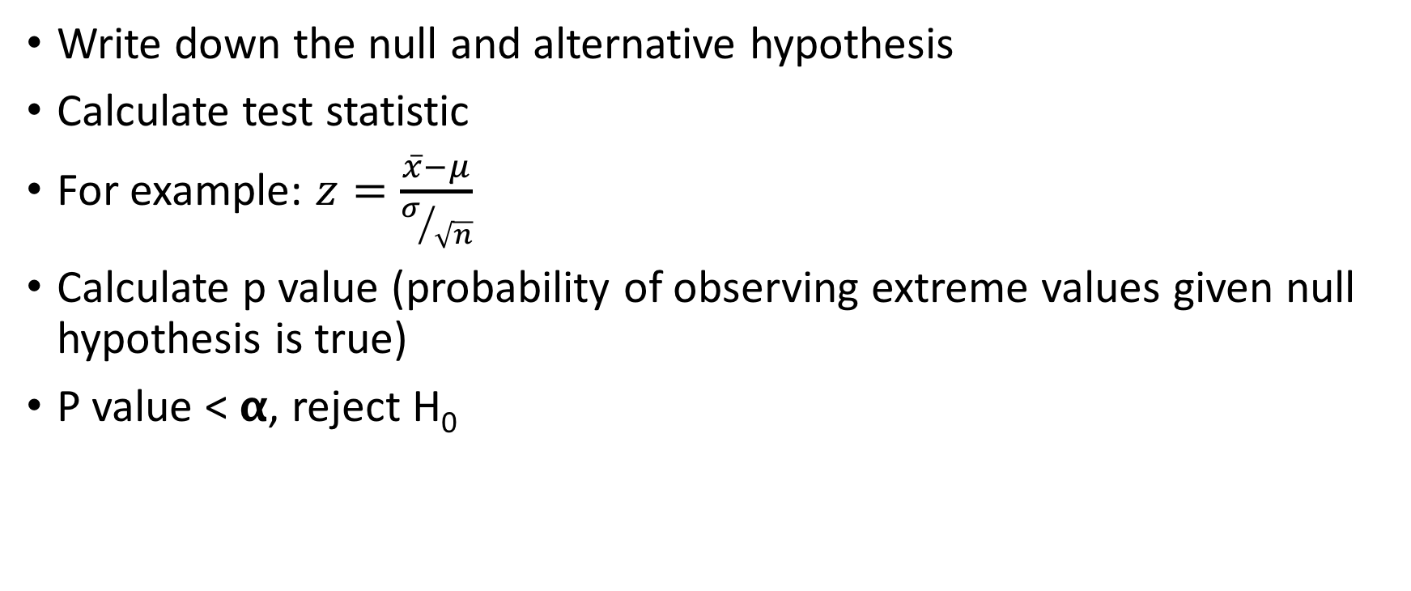
How to solve questions related to p-value?
Write down the null and alternative hypothesis
Calculate test statistic
For example: $z=\frac{\overline{x}−μ}{σ/{\sqrt{n}}}$
Calculate p value (probability of observing extreme values given null hypothesis is true)
P value < 𝝰, reject H₀

Slide 19
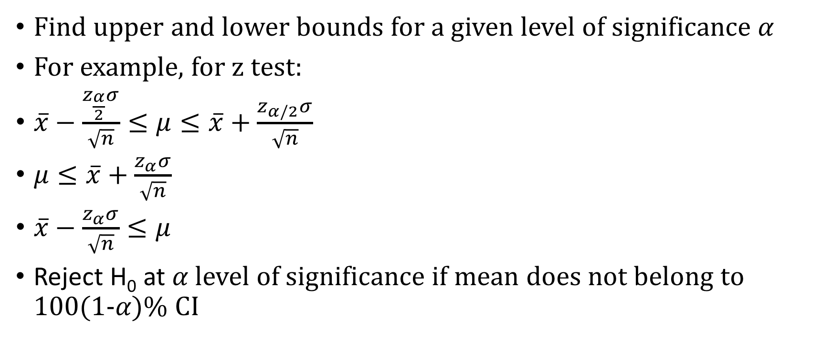
Confidence Interval
Find upper and lower bounds for a given level of significance 𝛼
For example, for z test:
$\overline{x}−\frac{z_{\frac{α}{2}}σ}{\sqrt{n}}≤μ≤\overline{x}+\frac{z_{α/2}σ}{\sqrt{n}}$
$μ≤\overline{x}+\frac{z_{α}σ}{\sqrt{n}}$
$\overline{x}−\frac{z_{α}σ}{\sqrt{n}}≤μ$
Reject H₀ at 𝛼 level of significance if mean does not belong to 100(1-𝛼)% CI

Slide 20
Inferences on a population
Inference
Mean
Variance known
Variance unknown
Variance
Chi-square test
Z test
T test

Slide 21
Inferences on a population
Inference
Mean
Variance known
Variance unknown
Variance
Chi-square test
Z test
T test

Slide 22

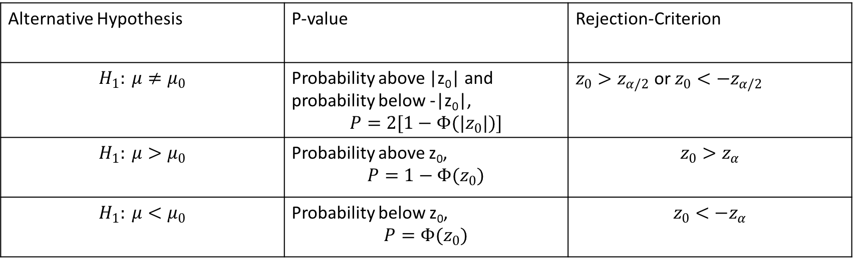
Z-test
$H_{0}: μ=μ_{0}$
Test statistic: $z_{0}=\frac{\overline{X}−μ_{0}}{σ/{\sqrt{n}}}$
Alternative Hypothesis | P-value | Rejection-Criterion
$$H_{1}: μ≠μ_{0}$$ | Probability above |z₀| and probability below -|z₀|, $$P=2[1−Φ(|z_{0}|)]$$ | $z_{0}>z_{α/2}$ or $z_{0}<−z_{α/2}$
$$H_{1}: μ>μ_{0}$$ | Probability above z₀, $$P=1−Φ(z_{0})$$ | $$z_{0}>z_{α}$$
$$H_{1}: μ<μ_{0}$$ | Probability below z₀, $$P=Φ(z_{0})$$ | $$z_{0}<−z_{α}$$

Slide 23



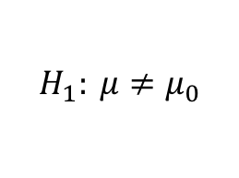
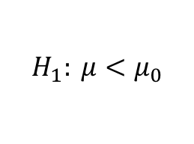
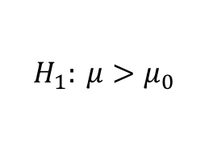
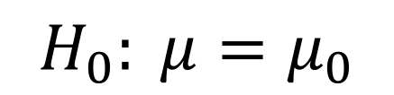
Two-tailed test
$$H_{0}: μ=μ_{0}$$
N(0,1)
P-value = $2[1−Φ(|z_{0}|)]$
-z₀
0
z₀
Lower-tailed test
$$H_{1}: μ≠μ_{0}$$
Upper-tailed test
N(0,1)
N(0,1)
P-value = $Φ(z_{0})$
P-value = $1−Φ(z_{0})$
-z₀
0
0
z₀
$$H_{1}: μ<μ_{0}$$
$$H_{1}: μ>μ_{0}$$

Slide 24







Type II error
Under $H_{0}:μ=μ_{0}$
Under $H_{1}:μ≠μ_{0}$
Distribution of Z₀ when H₁ is true:
$$Z_{0}\sim N(\frac{δ\sqrt{n}}{σ},1)$$
Type II error: probability that Z₀ is between $(−z_{\frac{α}{2}},z_{\frac{α}{2}})$
N(0,1)
N($\frac{δ\sqrt{n}}{σ},1$)
𝛽
$${−z}_{α/2}$$
$$z_{α/2}$$

Slide 25
Inferences on a population
Inference
Mean
Variance known
Variance unknown
Variance
Chi-square test
Z test
T test

Slide 26

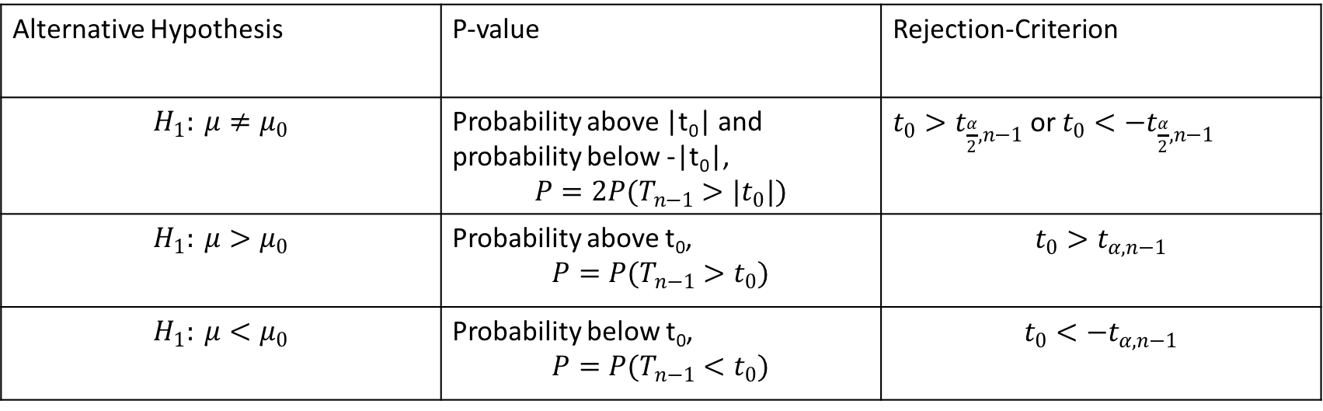
T-test
$H_{0}: μ=μ_{0}$
Test statistic: $T_{0}=\frac{\overline{X}−μ_{0}}{S/{\sqrt{n}}}$
Alternative Hypothesis | P-value | Rejection-Criterion
$$H_{1}: μ≠μ_{0}$$ | Probability above |t₀| and probability below -|t₀|, $$P=2P(T_{n−1}>|t_{0}|)$$ | $t_{0}>t_{\frac{α}{2},n−1}$ or $t_{0}<−t_{\frac{α}{2},n−1}$
$$H_{1}: μ>μ_{0}$$ | Probability above t₀, $$P=P(T_{n−1}>t_{0})$$ | $$t_{0}>t_{α,n−1}$$
$$H_{1}: μ<μ_{0}$$ | Probability below t₀, $${P=P(T}_{n−1}<t_{0})$$ | $$t_{0}<−t_{α,n−1}$$
Do not extrapolate from t-table. Just find range of p value

Slide 27
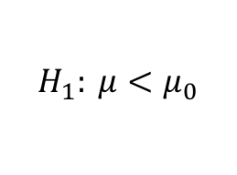
Two-tailed test
t_{n-1}
P-value = probability in both tails
-t₀
0
t₀
Lower-tailed test
$$H_{1}: μ≠μ_{0}$$
Upper-tailed test
t_{n-1}
t_{n-1}
P-value
P-value
-t₀
0
0
t₀
$$H_{1}: μ<μ_{0}$$
$$H_{1}: μ>μ_{0}$$

Slide 28


Type II error: Use OC curve
$$=β$$
$$={|δ|}/s$$
Notes:
OC curve taken from the book

Slide 29
Inferences on a population
Inference
Mean
Variance known
Variance unknown
Variance
Chi-square test
Z test
T test

Slide 30
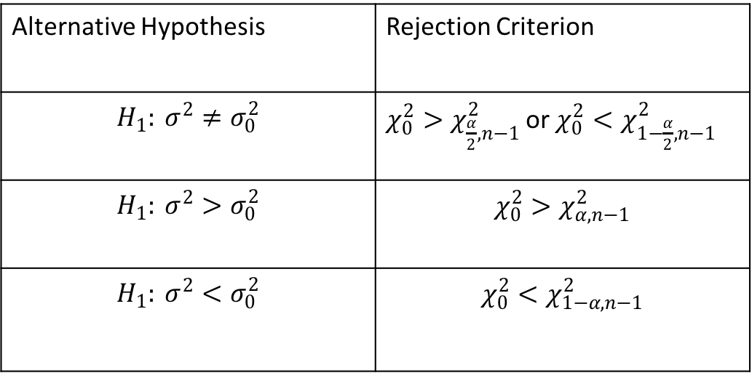

Chi-square test for normal population
$H_{0}: σ^{2}=σ_{0}^{2}$
Test statistic: $χ_{0}^{2}=\frac{(n−1)S^{2}}{σ_{0}^{2}}$
k=0.5
Alternative Hypothesis | Rejection Criterion
$$H_{1}: σ^{2}≠σ_{0}^{2}$$ | $χ_{0}^{2}>χ_{\frac{α}{2},n−1}^{2}$ or $χ_{0}^{2}<χ_{1−\frac{α}{2},n−1}^{2}$
$$H_{1}: σ^{2}>σ_{0}^{2}$$ | $$χ_{0}^{2}>χ_{α,n−1}^{2}$$
$$H_{1}: σ^{2}<σ_{0}^{2}$$ | $$χ_{0}^{2}<χ_{1−α,n−1}^{2}$$
k=3
k=5
Chi-square distribution

Slide 31












$$χ_{n−1}^{2}$$
$$H_{0}: σ^{2}=σ_{0}^{2}$$
$$α/2$$
$$α/2$$
$$χ_{1−α/2,n−1}^{2}$$
$$χ_{α/2,n−1}^{2}$$
$$H_{1}:σ^{2}≠σ_{0}^{2}$$
$$χ_{n−1}^{2}$$
$$χ_{n−1}^{2}$$
$$α$$
$$α$$
$$χ_{α,n−1}^{2}$$
$$χ_{1−α,n−1}^{2}$$
$$H_{1}:σ^{2}>σ_{0}^{2}$$
$$H_{1}:σ^{2}<σ_{0}^{2}$$

Slide 32
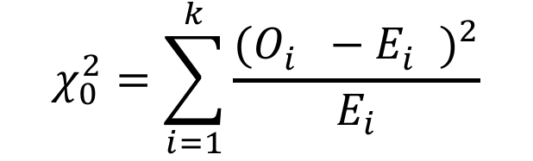
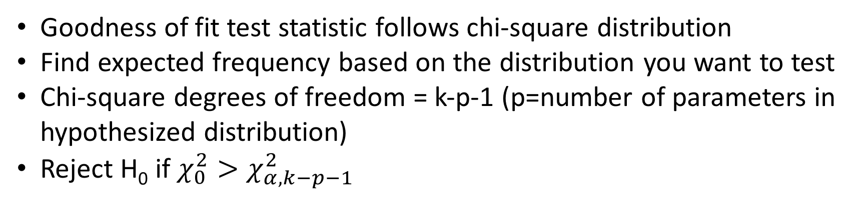
Goodness of fit
Observed frequency
Expected frequency
Number of bins/class intervals
$$χ_{0}^{2}=\sum_{i=1}^{k}{\frac{{(O_{i}^{}−E_{i}^{})}^{2}}{E_{i}}}$$
Chi-square distribution
Goodness of fit test statistic follows chi-square distribution
Find expected frequency based on the distribution you want to test
Chi-square degrees of freedom = k-p-1 (p=number of parameters in hypothesized distribution)
Reject H₀ if $χ_{0}^{2}>χ_{α,k−p−1}^{2}$

Slide 33
Chapter 4
Point Estimation
Biased/unbiased estimators
Hypothesis testing
One sided/two sided
Mean; variance known
Z test
Mean; variance unknown
T test
Variance of normal population
Chi-square test
Goodness of fit
Type I/type II errors
Chi-square test
Confidence Intervals
P values
Compute z values for type I and type II
OC curve for type II error; n-1 d.o.f.
n-1 d.o.f.
k-p-1 d.o.f.

